Slide 1

Team: BEKO
Improving IT service delivery to federal departments
February 2022

Slide 2
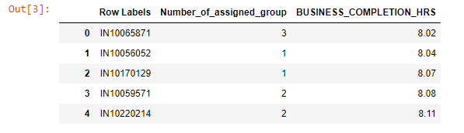
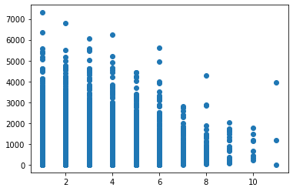
1. Number of assigned group vs Business Completion time

Slide 3
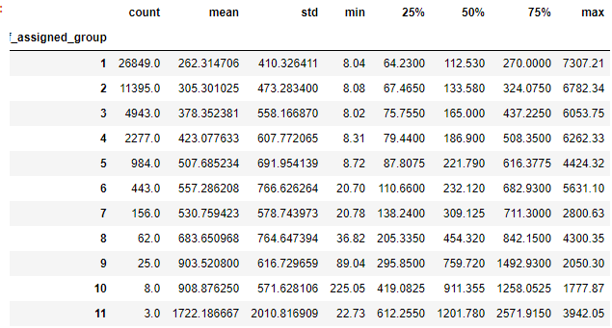
1. Number of assigned group vs Business Completion time

Slide 4
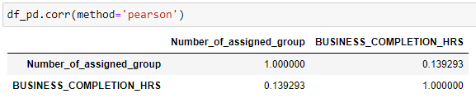
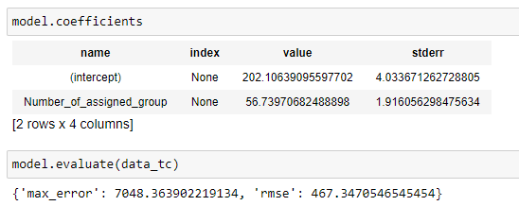
1. Number of assigned group vs Business Completion time
Hour = 202+57 *# of assig_group

Slide 5
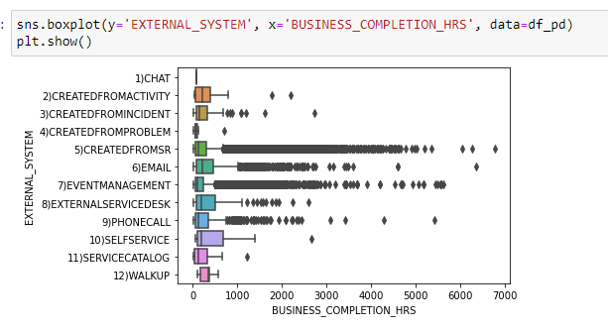
5. External_System vs Business Completion time

Slide 6
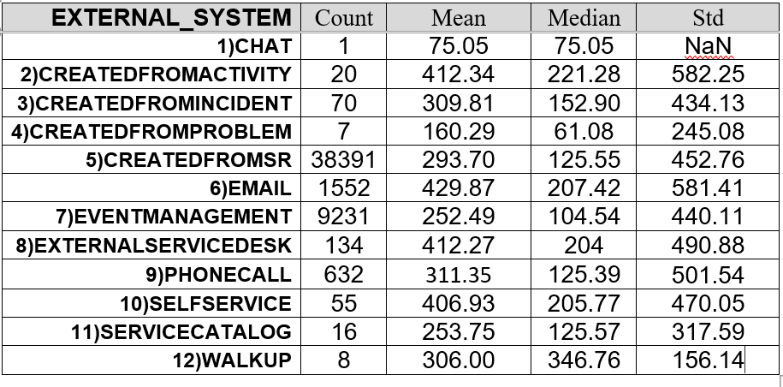
5. External_System vs Business Completion time

Slide 7
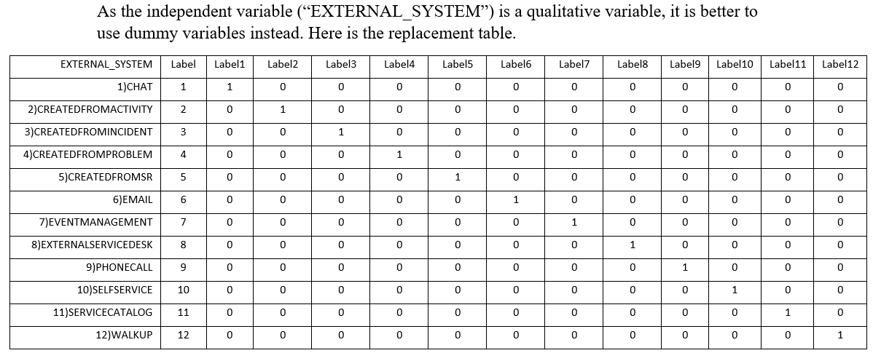
5. External_System vs Business Completion time

Slide 8
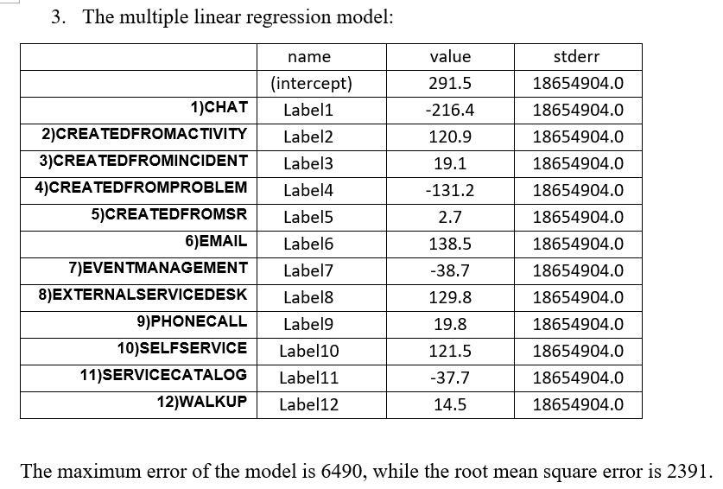
5. External_System vs Business Completion time

